Slide 1
AFSC EBS BTS Survey Net Figure
Emily Markowitz January 12 2025

Slide 2
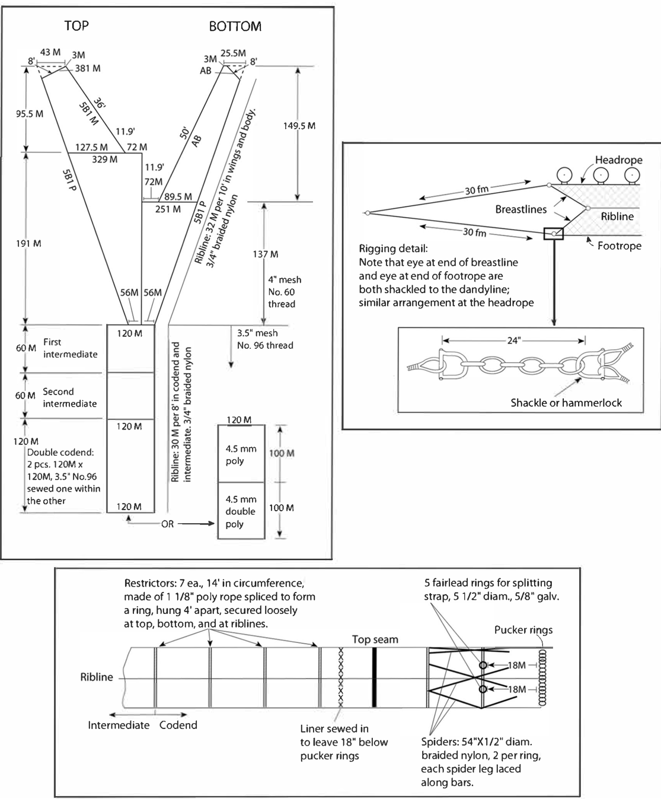
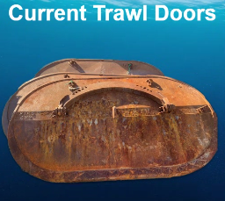
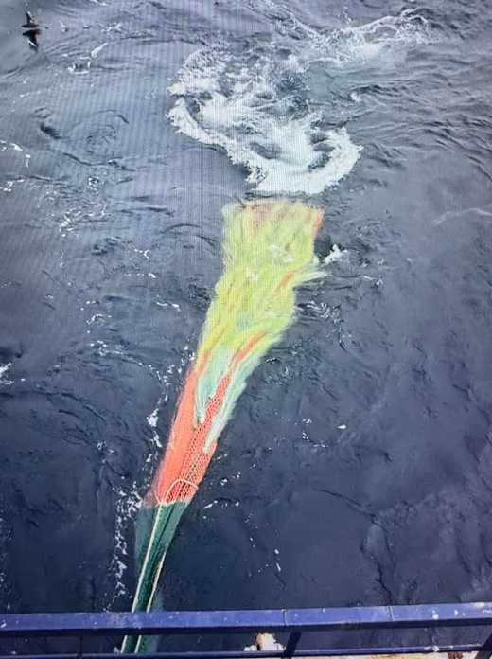
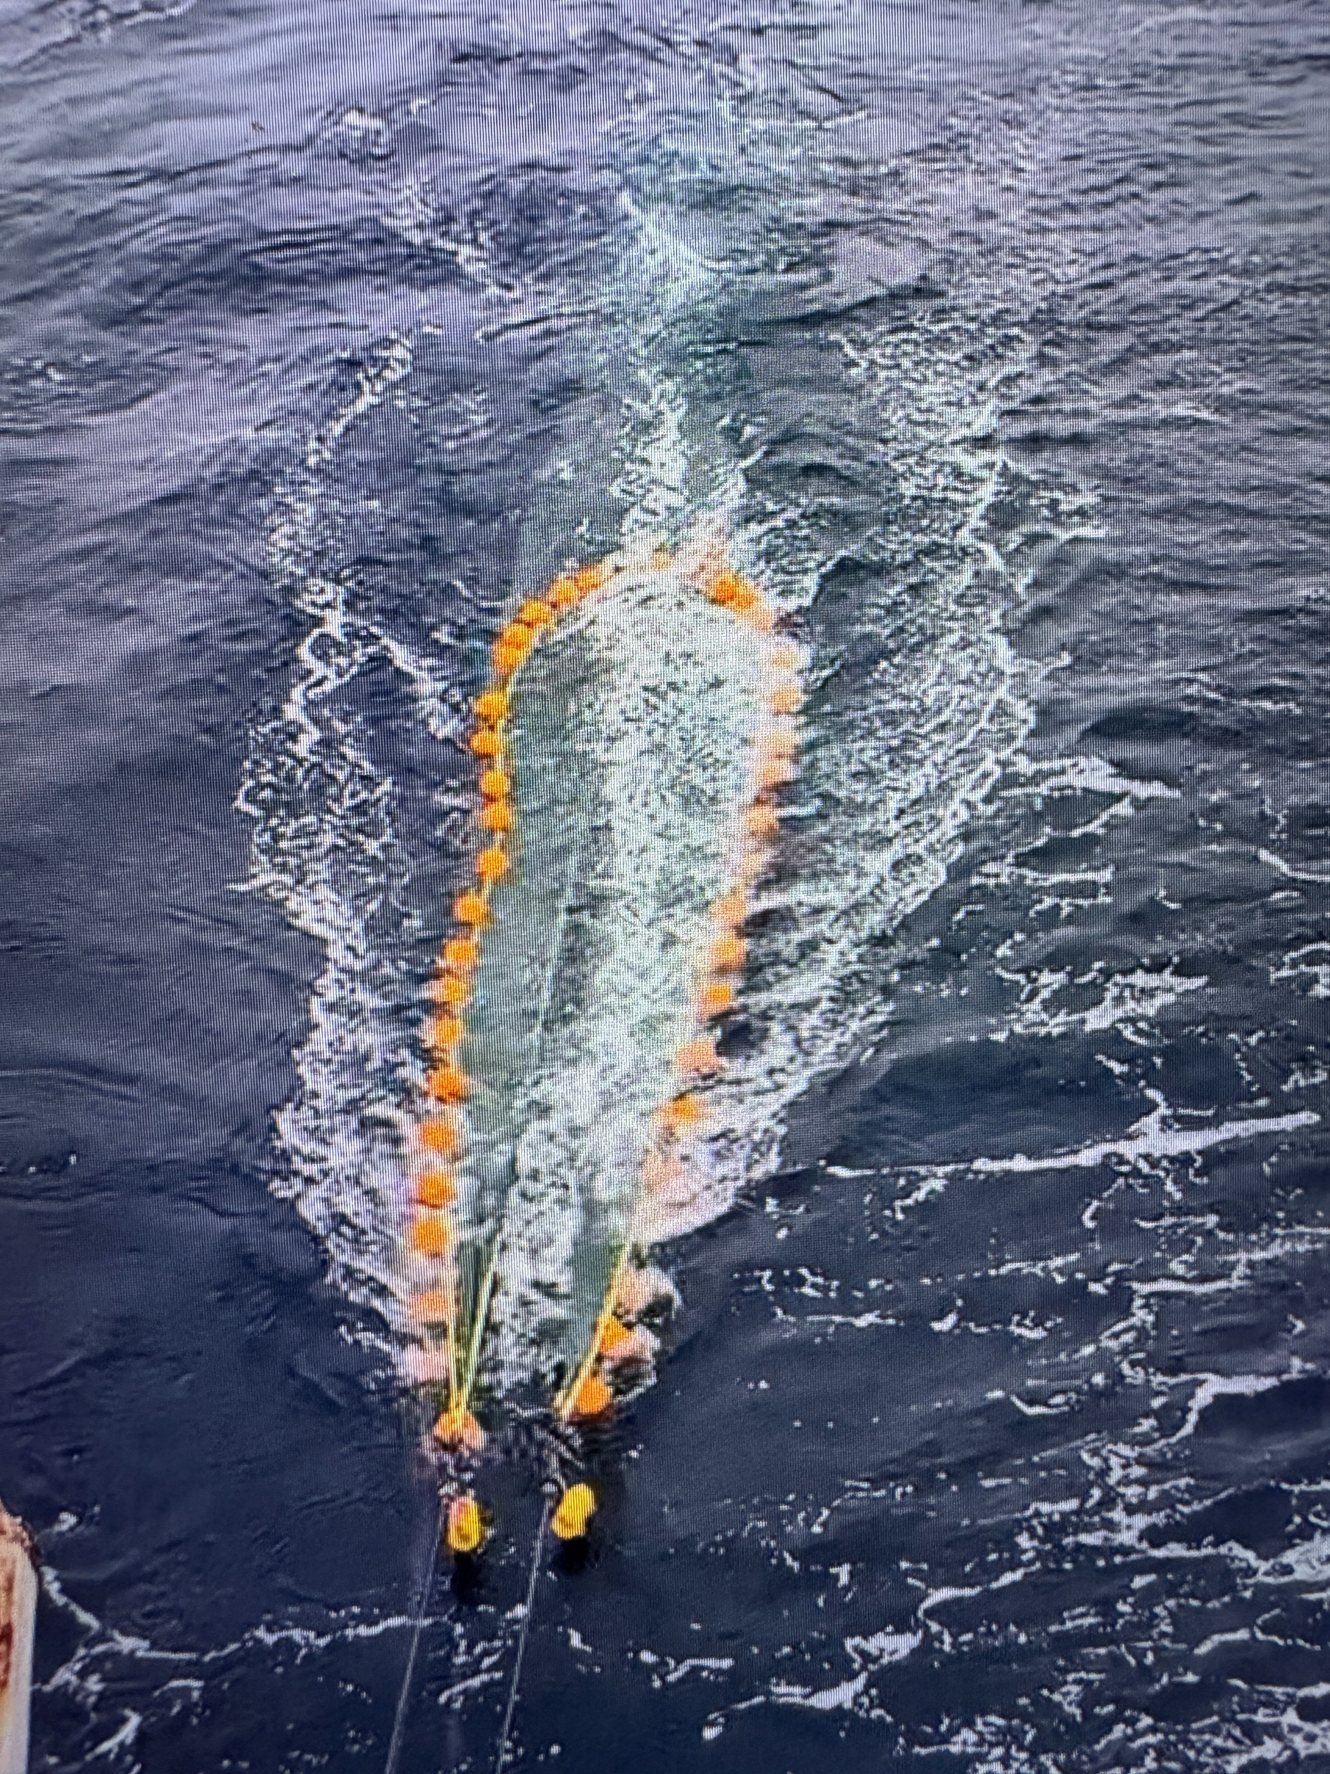
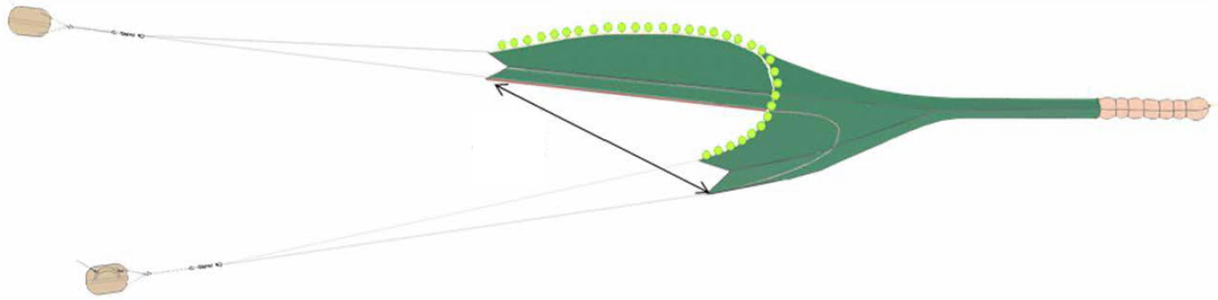
AFSC EBS and NBS Net
For reference

Slide 3
Selvedge
Cod End
TB4
EXT(T)
TB2
EXT(B)
TB3
BB4
TS
TB1
SP4
BB3
Rockhopper Sweep
SP3
BB2
TW1
SP2
BB1
TW1 | Top Wing
SP1-4 | Side Panels 1 through 4
BW1 | Bottom Wing
TS | Top Square
BB1-4 | Bottom Belly Panels 1 through 4
TB1-4 | Top Belly Panels 1 through 4
EXT | Top (T) and Bottom (B) Exit
T/M/BJ | Top (T), Middle (M), Bottom (B) Jib
Bunt
TJ
Bunt
SP1
MJ
BW1
BJ
NEFSC Net
For reference

Slide 4

It looks like this is intended to be a diagram of the 83-112. If it is, it should have:
- A smooth footrope (steel rope wrapped in poly line and rubber fire hose) instead of rockhopper gear with bobbins
- Headrope further forward relative to the bosom of the footrope
- Longer back-end relative to the forward section
- More rounded otter doors
- Spread sensors oriented the wrong way along the axis of the upper bridle.
- Cod end strap (perhaps less important)
- Chafing mat on the bottom of the cod end
Marport spread sensor
Codend
Marport Headrope Sensor
Headrope & Buoys
Hood
2nd Intermediate
Chafing gear
Footrope: Steel rope wrapped in poly line and rubber fuel hose
1st Intermediate
Bottom belly
Warp wires to ship
TW1 | Top Wing
SP1-4 | Side Panels 1 through 4
BW1 | Bottom Wing
TS | Top Square
BB1-4 | Bottom Belly Panels 1 through 4
TB1-4 | Top Belly Panels 1 through 4
EXT | Top (T) and Bottom (B) Exit
T/M/BJ | Top (T), Middle (M), Bottom (B) Jib
Bunt
Otter Doors
Bottom wing
Top wing
Bridels
AFSC Bering Sea 83-112 Eastern trawl net
Draft 2.0

Slide 5
Final figures

Slide 6
Codend
Marport spread sensor
Headrope & Buoys
Marport Headrope Sensor
Hood
2nd Intermediate
Chafing gear
1st Intermediate
Footrope: Steel rope wrapped in poly line and rubber fuel hose
Bottom belly
Warp wires to ship
Bottom wing
Otter Doors
Top wing
Bridels
AFSC Bering Sea 83-112 Eastern trawl net
Draft 2.0

Slide 7
Marport spread sensor
Cod End
Headrope & Buoys
Marport Headrope Sensor
2nd Intermediate
Hood
1st Intermediate
Chafing gear
Footrope: Steel rope wrapped in poly line and rubber fuel hose
Warp wires to ship
Bottom belly
Otter Doors
Bottom wing
Top wing
Bridles
AFSC Bering Sea 83-112 Eastern trawl net

Slide 8
Marport spread sensor
Headrope & Buoys
Otter Doors
Marport Headrope Sensor
Warp wires to ship
Chafing gear
Footrope: Steel rope wrapped in poly line and rubber fuel hose
Hood
Codend
2nd Intermediate
Bridles
1st Intermediate
Bottom belly
Bottom wing
Top wing
AFSC Bering Sea Survey 83-112 Eastern Trawl Net

Slide 9
AFSC Bering Sea Survey 83-112 Eastern Trawl Net

Slide 10
Marport spread sensor
Headrope & Buoys
Otter Doors
Marport Headrope Sensor
Warp wires to ship
Chafing gear
Footrope: Steel rope wrapped in poly line and rubber fuel hose
Hood
Codend
2nd Intermediate
Bridels
1st Intermediate
Bottom belly
Bottom wing
Top wing
AFSC Bering Sea Survey 83-112 Eastern Trawl Net

Slide 11
Otter Doors
Marport spread sensor
Headrope & Buoys
Marport Headrope Sensor
Codend
Footrope: Steel rope wrapped in poly line and rubber fuel hose
Hood
2nd Intermediate
1st Intermediate
Bottom belly
Warp wires to ship
Bridles
Top wing
Bottom wing
AFSC Bering Sea Survey 83-112 Eastern Trawl Net

Slide 12
AFSC Bering Sea Survey 83-112 Eastern Trawl Net

Slide 13



